Slide 1
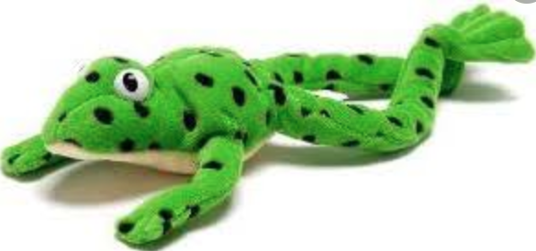
PHONICS
week 1
week beginning 22nd June 2020

Slide 2
Dear Parents/Carers and children,
It’s important to keep up with Phonics learning even though we are not at school. Read, Write, Inc lessons are streamed daily at 10.30am and are available on YouTube for 24 hours. These follow the same format as the children are used to in school.
This week we have planned three lessons. They are streamed on Monday, Tuesday and Wednesday but you can choose to use them either live or later in the day or the following day. If you would like to watch the Thursday and Friday lessons they will be available at the same time. Please follow the link below for all the sessions.
If you would like a further challenge, Read, Write, Inc also stream spellings linked to the daily phonics lesson. The live session starts at 10.45 but will also be available for 24 hours. The following slides will guide you through.
https://www.youtube.com/channel/UCo7fbLgY2oA_cFCIg9GdxtQ
I hope you enjoy the sessions.
Mrs Rosewell
English Lead

Slide 3
Lesson 1 Monday
Today you are going to learn about the trigraph ear.
Follow the link below to start the lesson. Please choose the set 3 speed sounds. The lesson is streamed live at 10.30am but is available for 24 hours.
https://www.youtube.com/channel/UCo7fbLgY2oA_cFCIg9GdxtQ
Once the lesson has finished try to read the words with the ear trigraph and the alien (nonsense) words on the next two slides.

Slide 4
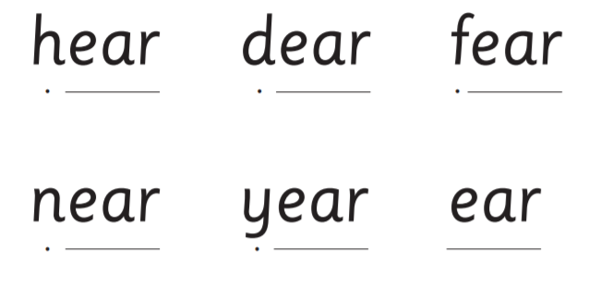
Can you read the words and put them in a sentence?
Say your sentence to someone.

Slide 5
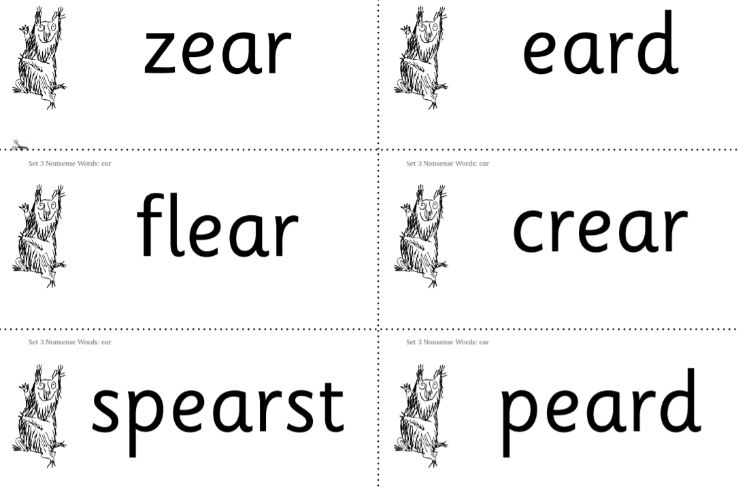
Can you read these alien words?
What a load of nonsense!

Slide 6
Challenge: reading longer ee/ea words
Click on the link below to watch today’s lesson on reading longer ee/ea words
https://www.youtube.com/watch?v=U_zJ1OkNMxM

Slide 7
Lesson 2 Tuesday
Today you are going to learn about the trigraph ure.
Follow the link below and choose the set 3 speed sounds to start the lesson.
https://www.youtube.com/channel/UCo7fbLgY2oA_cFCIg9GdxtQ
Once the lesson has finished try to read the words with the ure trigraph and the alien
(nonsense) words on the next two slides.

Slide 8
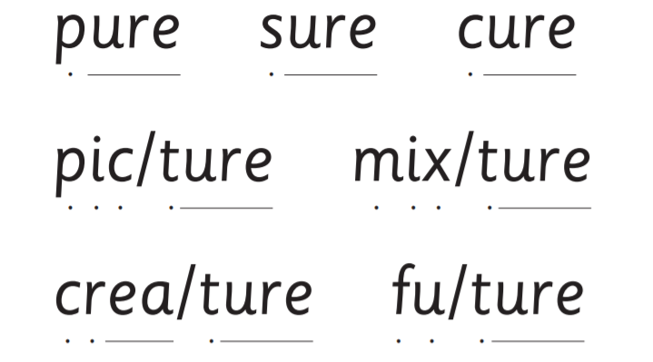
Can you read the words and put them in a sentence?
Say your sentence to someone.

Slide 9
Challenge: reading longer oy/oi words
Click on the link below to watch today’s lesson on reading longer oy/oi words.
https://www.youtube.com/watch?v=U_zJ1OkNMxM

Slide 10
Lesson 3 Wednesday
Today you are going to review the digraph ea.
Follow the link below and choose set 3 speed sounds to start the lesson.
https://www.youtube.com/channel/UCo7fbLgY2oA_cFCIg9GdxtQ
Once the lesson has finished try to read the words with the ea digraph and the alien
(nonsense) words on the next two slides.

Slide 11
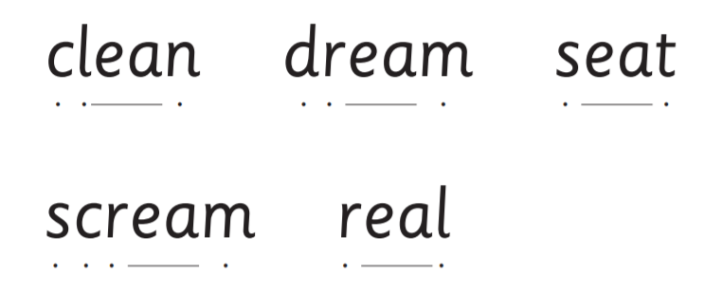
Can you read the words and put them in a sentence?
Say your sentence to someone.

Slide 12
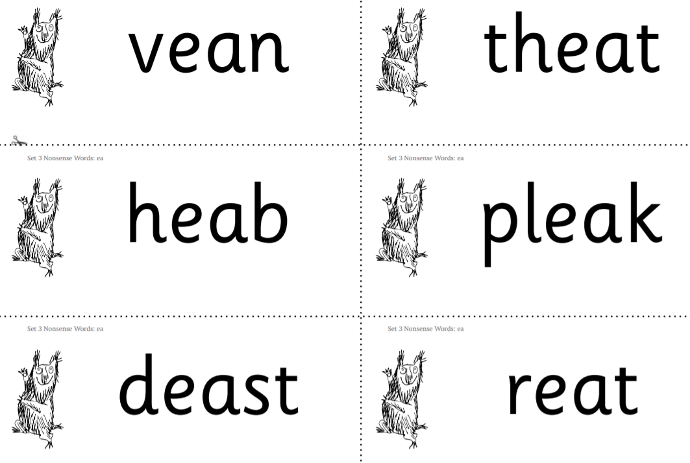
Can you read these alien words?
What a load of nonsense!

Slide 13
Challenge: reading longer ay/a-e/ai words
Click on the link below to watch today’s lesson on reading longer ay/a-e/ai words.
https://www.youtube.com/watch?v=U_zJ1OkNMxM

